Slide 1
Chap30. Thread Synchronization

Slide 2




Critical section

Slide 3

Critical section
Critical section
Thread 2
Thread 4
Thread 1
Thread 3
Critical section
Thread 2
Thread 4
Thread 1
Thread 3

Slide 4
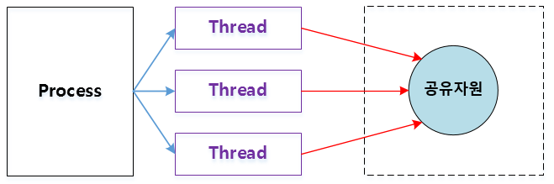
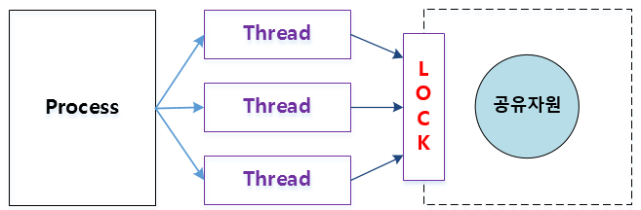
Critical section
Critical Section is refer to a section of code that accesses a shared resource
Critical section
Critical section

Slide 5
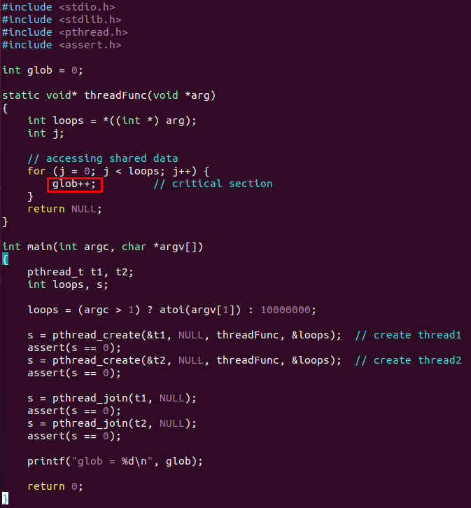
Critical section
Example code
Main thread
Thread 1
Thread 2
wait for t1
threadFunc()
interrupt
threadFunc()

Slide 6
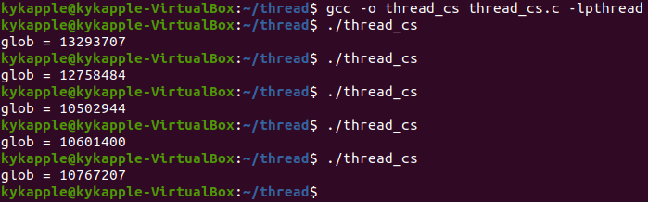
Critical section
Expected results
Results of example code
glob = 20000000

Slide 7

Critical section
Critical section
High level
movl 0x8049420, %eax
addl $0x1, %eax
movl %eax, 0x8049420
Assembly level
Main Memory
Thread 1
Thread 2
1. eax
2. add $0x1
3. eax
1. eax
2. add $0x1
3. eax
0x8049420

Slide 8
Critical section
Thread 1
Thread 2
glob = 0
glob = 1000
glob = 1000
Interrupt
glob = 1999
movl 0x8049420, %eax
addl $0x1, %eax
Interrupt(eax = 2000)
glob = 1999
movl %eax, 0x8049420
glob = 2999
movl %eax, 0x8049420
glob = 2000
glob = 2999
Interrupt
glob = 3000
glob = 3000
Interrupt
glob = 20000000

Slide 9

Mutual exclusion(mutex)
Mutex – Prevents multiple threads from accessing shared data(synchronizes access to a shared resource)
Critical section
Critical section

Slide 10
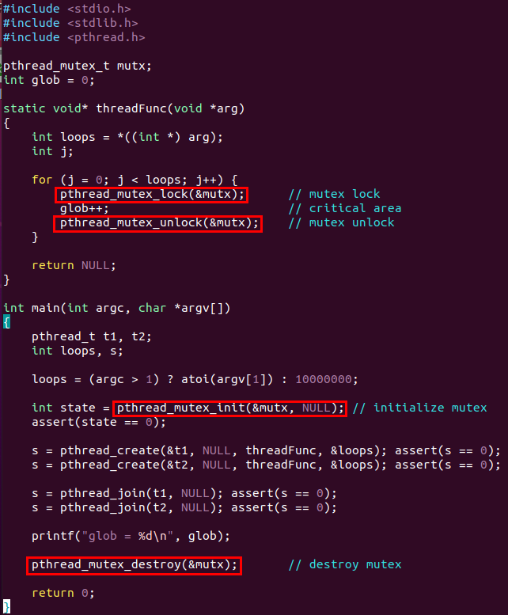

Mutual exclusion(mutex)
Example code of using mutex
Thread 1
Thread 2
acquires the lock
blocks until the mutex is unlocked
Critical section
glob++;
Only one thread can enter a critical section

Slide 11
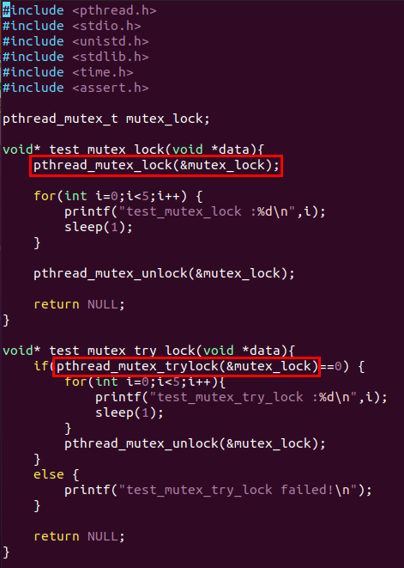
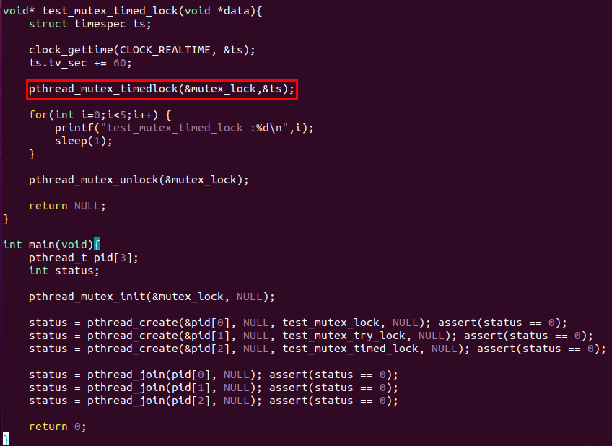
Mutual exclusion(mutex)
pthread_mutex_trylock() / pthread_mutex_timedlock()

Slide 12
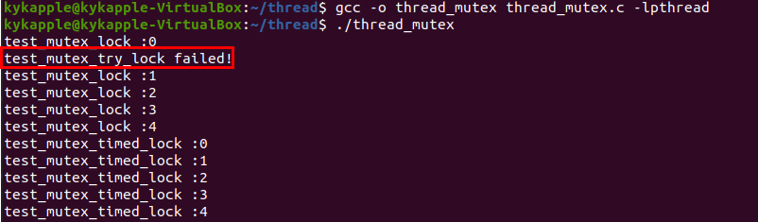
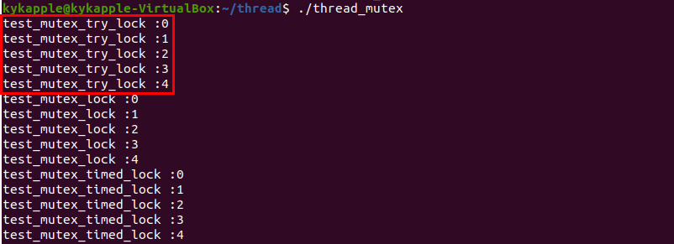
Mutual exclusion(mutex)
Results of example code

Slide 13
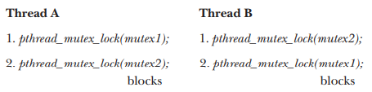
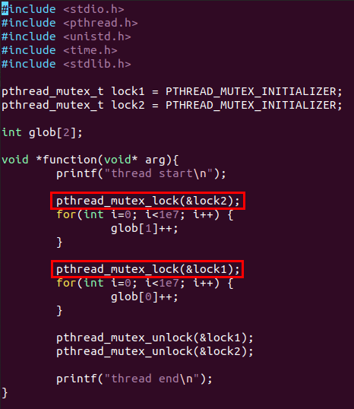
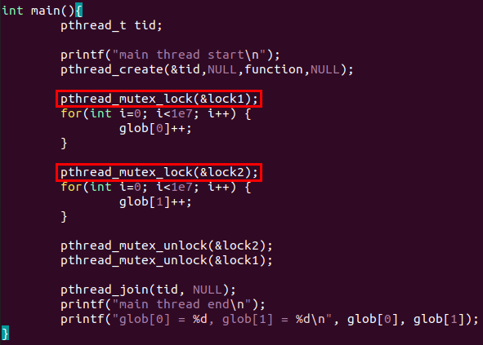
Mutex deadlocks
Deadlock situation can arise when more than one thread is locking the same set of mutexes.
each thread successfully locks one mutex, and then tries to lock the mutex that the other thread has already locked. Both threads will remain blocked indefinitely.

Slide 14
Avoid deadlocks
Define a mutex hierarchy
Thread B
Thread A
Thread B
Thread A
Try, and then back off
lock(mutex1)
lock(mutex1)
lock(mutex2)
lock(mutex1)
Using pthread_mutex_trylock()
lock(mutex2)
lock(mutex2)
lock(mutex1)
lock(mutex2)
same as pthread_mutex_lock(),
except that if the mutex is currently locked,
pthread_mutex_trylock() fails,
returning the error EBUSY.
unlock(mutex2)
unlock(mutex1)
unlock(mutex1)
unlock(mutex2)
unlock(mutex2)
unlock(mutex1)
unlock(mutex2)
unlock(mutex1)

Slide 15

Condition variables
A condition variable is an object able to block the thread until notified to resume.
Useful when assigning an order relation between threads
The pthread_cond_wait() function blocks a thread until the condition variable cond is signaled.
The pthread_cond_signal() and pthread_cond_broadcast() functions both signal the condition variable specified by cond.

Slide 16
Condition variables
Thread A
Thread B
pthread_mutex_lock()
pthread_mutex_lock()
pthread_cond_wait()
code to perform
pthread_mutex_unlock()
pthread_cond_signal()
Resume(Signal received)
pthread_mutex_lock()
pthread_mutex_unlock()
code to perform
pthread_mutex_unlock()

Slide 17
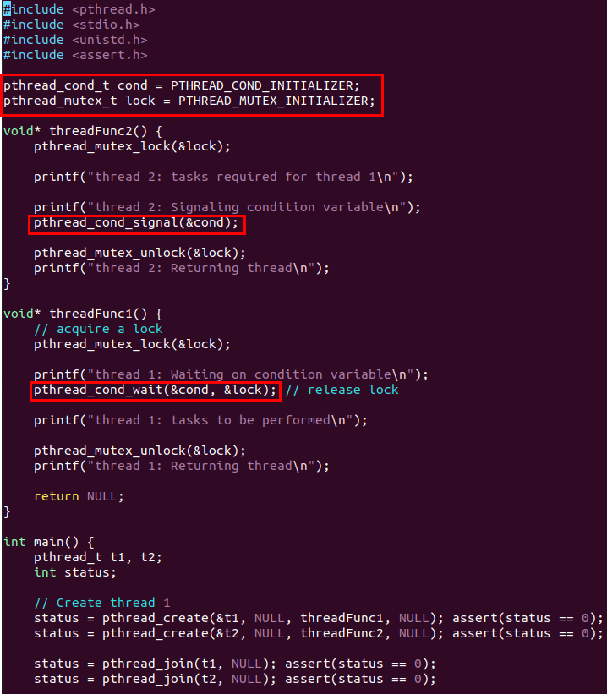

Condition variables
Example code
Thread 1
Thread 2
acquire lock
acquire lock
tasks required for thread 1
waiting on condition variable
release lock
Resume(Signal received)
signaling on condition variable
acquire lock
release lock
tasks to be performed
release lock

Slide 18
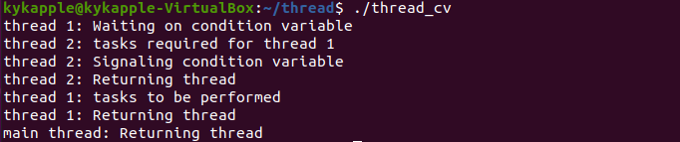
Condition variables
Results of example code

Slide 19
Q & A

